Slide 1
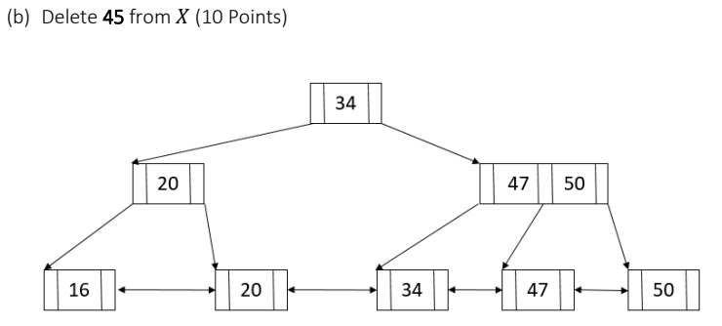
This is the solution that exactly matches to the discussion in the lectures/textbook (the posted solution makes a further optimization in the non-leaf node <45, 50> which is not discussed in the textbook)

Slide 2
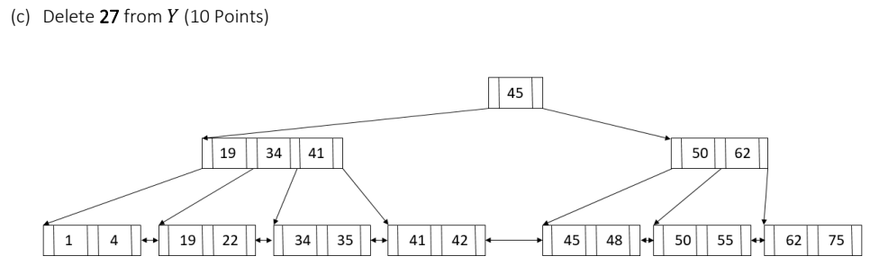
The same case as in the previous slide.

